Slide 1
Agenda
Data source update
Study outline
DAG
CausalML package

Slide 2
Study outline
Problem statement
Data description
Method
Experiment and Evaluation
Discussion
Conclusion

Slide 3
DAG
Causal discovery
Expert domain knowledge

Slide 4

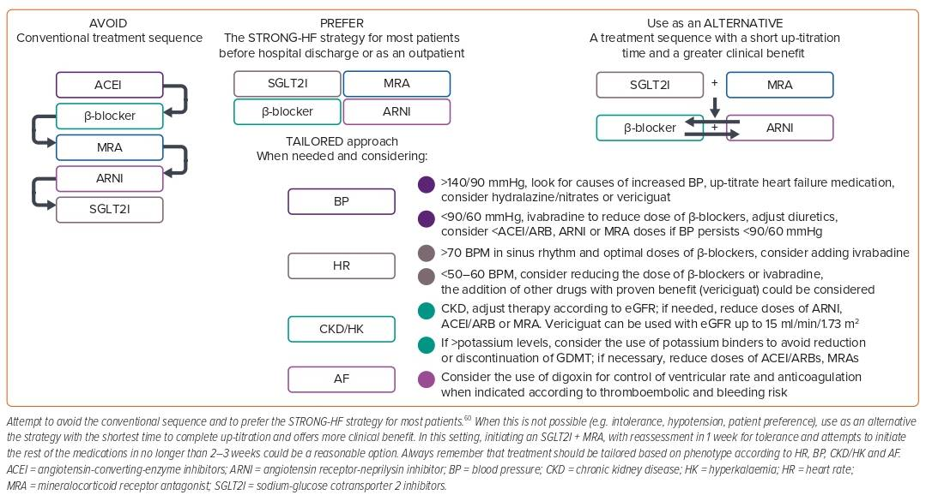
Carrizales-Sepúlveda EF, Ordaz-Farías A, Vargas-Mendoza JA, Vera-Pineda R, Flores-Ramírez R
Figure 3: Sequences of Guideline-directed Medical Therapy Initiation in Patients with Heart Failure
Citation: Cardiac Failure Review 2024;10:e03.
https://doi.org/10.15420/cfr.2023.20

Slide 5
causality
Clinical practice (clinical characteristics)
NYHA Classification III/IV
Marked limitation of physical activity. Comfortable at rest. Less than ordinary activity causes fatigue, palpitation, shortness of breath or chest pain
Symptoms of heart failure at rest. Any physical activity causes further discomfort.
KCCQ categorization https://www.ahajournals.org/doi/10.1161/circoutcomes.115.001958
the 23-item, disease-specific
Physical Limitation: 6 items
Symptom Frequency: 4 items
Symptom Burden: 3 items
Self-Efficacy: 2 items
Quality of Life: 3 items
Social Limitations: 4 items
Other data-driven

Slide 6
Python causalml packages
causal-learn https://github.com/cmu-phil/causal-learn.
caualML https://github.com/uber/causalml.
DoubleML https://docs.doubleml.org/stable/index.html.
DoWhy https://py-hwy.github.io/dowhy.
Causal deep learning Deep Learning of Causal Structures in High Dimensions under Data Limitations

Slide 7
Questions
Thank you!

Slide 8
Introduction
Guideline-directed medical therapy (GDMT)
GDMT stands for guideline-directed medical therapy, which is clinical practice guidelines.
GDMT for heart failure is a drug-based therapy using a combination of up to four heart medications (ACEi, ARNi, Beta-blocker, MRA and sglt2i).
Studies show that GDMT for heart failure is effective and provides a foundation for doctors to treat people with HFrEF.
Spending extensive time determining treatment sequence and optimal titration may lead to missing the best treatment window.
Exploration of causal machine learning in healthcare.
Focus on personalizing GDMT for heart failure via individual treatment effect (ite) predictions.

Slide 9
Research Objective
To predict the ITE of various GDMT options for heart failure patients.
To personalize treatment plans based on patient-specific data.

Slide 10
Bold goal
This research aims to transform heart failure treatment by enabling more personalized and effective GDMT strategies.
Advancing precision medicine through tailored treatment strategies.
Improving patient outcomes and healthcare resource utilization.

Slide 11
Utilizing Causal ML to Personalize Guideline-Directed Medical Therapy (GDMT) for Heart Failure: Assessing Individual Treatment Effects
November 8th , 2024

